Slide 1
Hotel Reservation Analysis
Barakat Akinsiku

Slide 2
Contents
Introduction
Data Collection and Preparation
Data Manipulation in SQL
Data Visualization in Tableau
Key Insights
Recommendation

Slide 3
Introduction
The Hotel Reservation Analysis was carried out to analyze hotel reservation data from two different hotels; Resort hotel (H1) and City Hotel (H2) using SQL for data manipulation and Tableau for data visualization with the aim of uncovering interesting trends and insights.

Slide 4
Data Collection and Preparation
The dataset for the analysis was obtained from a publicly accessible GitHub repository and it contained information such as customer type, room type, meal type and booking reservations/cancellations.
The dataset was checked for datatype errors and other data anomalies before being imported into Microsoft SQL Server Management Studio (SSMS) for analysis.

Slide 5
Data Manipulation in SQL
The CREATE database and CREATE TABLE commands were used to copy the Hotel Reservation dataset into SSMS and subsequent analysis were done using other SQL commands to create calculated fields, measures and parameters.
Insights such as customer type distribution, hotel stay. arrival dates and market segment distribution were determined utilizing SQL queries.

Slide 6
Data Visualization in Tableau
The cleaned dataset was imported into tableau to create visualizations for explanatory storytelling through visualizing the insights obtained from the analysis in informative charts and diagrams.
Leveraging the drag and drop feature of tableau, analysis of different aspects of the dataset such as customer type, booking type, stay in weekend and week nights were carried out.

Slide 7
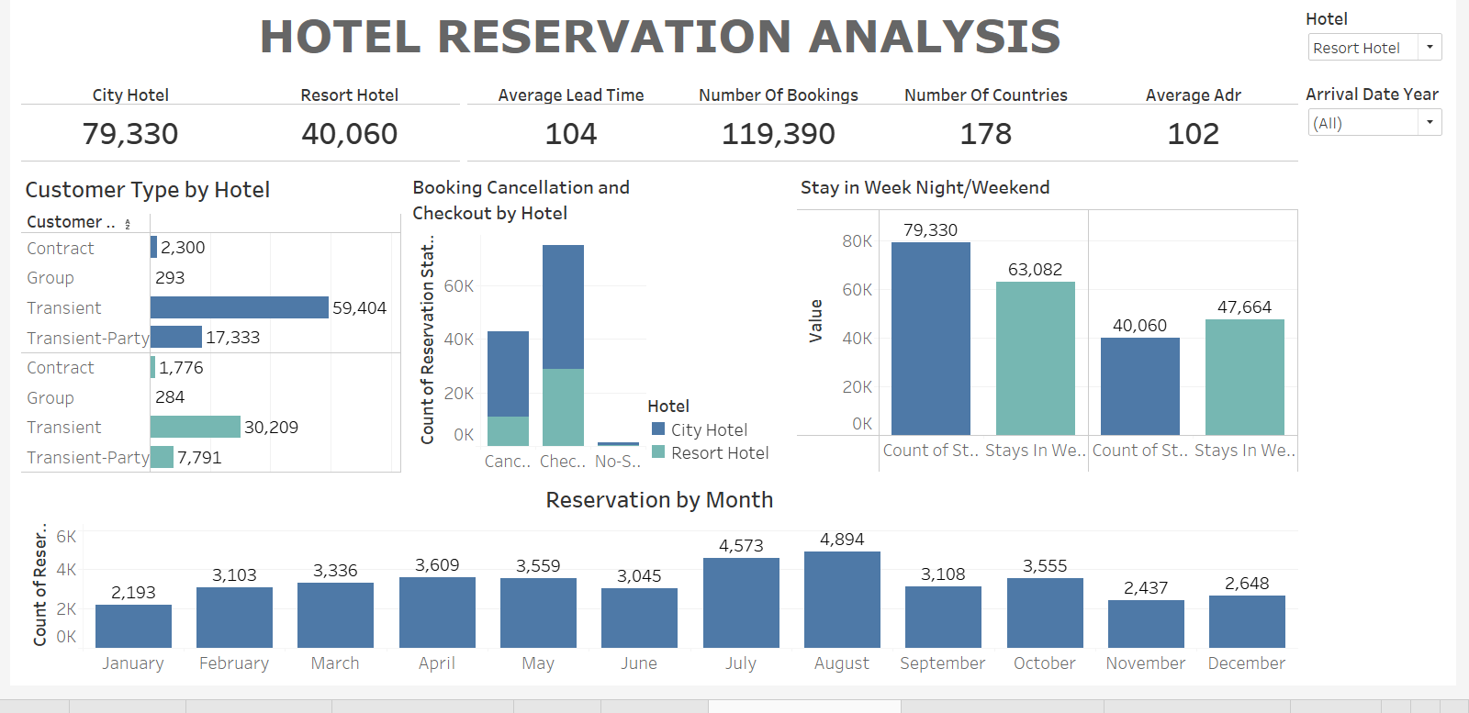

Slide 8
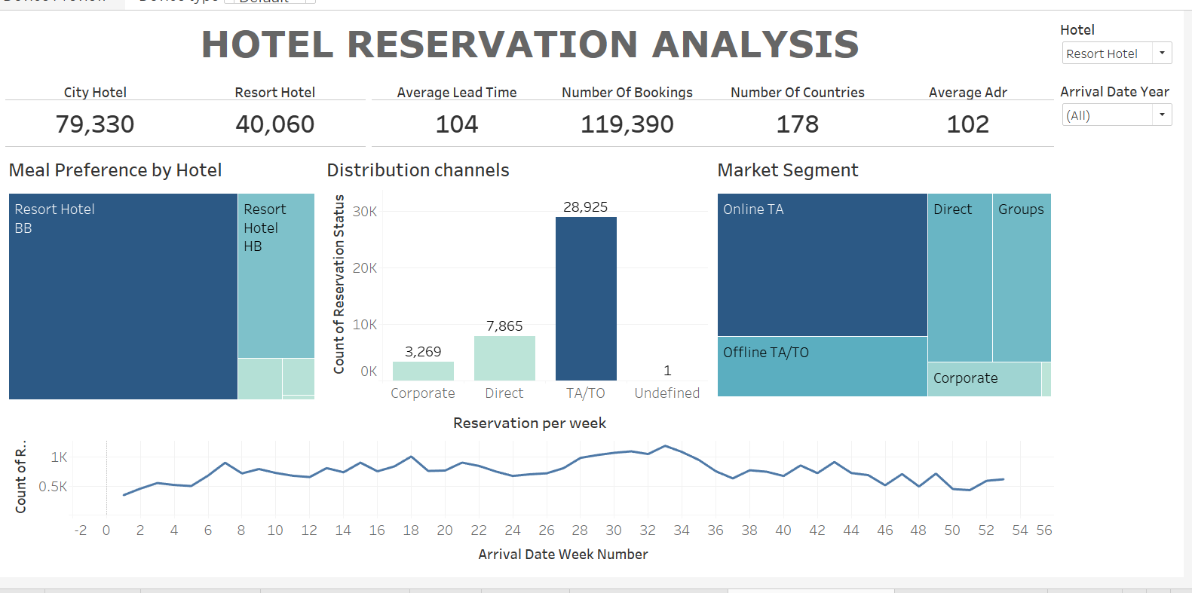

Slide 9
Key Insights
There were a total of 119,390 bookings over a period of three(3) years in both hotels. City Hotel had the most bookings at 79,330 while Resort Hotel had 40,060. The average lead time for both hotels was 104 while the average Adr was 102.
Individually, City Hotel had an average lead time of 109 days and a cancellation rate of 41.73% while Resort Hotel had an average lead time of 92 days and 27.76% cancellation rate.
Other segment specific analytical results and insights are detailed in the slides below:

Slide 10
Customer Type Analysis
The top customer types for City Hotel and Resort Hotel were found to be:
City Hotel
  Transient: 33,967 reservations
  Transient-Party: 12,850 reservations
  Groups: 6937 reservations
Resort Hotel
  Transient: 15,364 reservations
  Transient-Party: 7,717 reservations
  Groups: 5,836 reservations
Insights: Transient bookings dominate for both hotels. City hotels attract a considerable number of transient-party bookings while Resort hotels have a significant presence in group bookings.

Slide 11
Booking Distribution Channel Analysis
The top distribution channels for City Hotel and Resort Hotel were found to be:
City Hotel
  TA/TO: 68,945 reservations
  Direct: 6,780 reservations
  GDS: 193 reservations
Resort Hotel
  TA/TO: 28,925 reservations
  Direct: 7,865 reservations
  Corporate: 3,269 reservations
Insights: City hotels receive a substantial number of their reservations from Travel Agents/ Tour Operators (TA/TO) while Resort hotels have a strong presence in both TA/TO and Direct channels. Direct bookings are noteworthy for both hotel types.

Slide 12
Meal Type Analysis
Bed & Breakfast (BB) was the most preferred meal type for both hotels followed by Half Board (HB) meal type indicating a preference for breakfast and one other meal.
Full Board meal (FB) had a relatively lower count with instances of undefined or unspecified meal types. The count for meal type per reserved bookings are given below:
Meal Types for Both Hotels
  Bed & Breakfast (BB): 92,310 reservations
  Half Board (HB): 14,463 reservations
  Undefined/SC: 10,650 reservations
  Full Board (FB): 798 reservations
  Undefined: 1,169 reservations

Slide 13
Market Segment Analysis
The top market segments for City Hotel and Resort Hotel were found to be:
City Hotel
  Online TA: 38,748 reservations
  Groups: 13,975 reservations
  Offline TA/TO: 16,747 reservations
Resort Hotel
  Online TA: 17,729 reservations
  Groups: 5,836 reservations
  Corporate: 2,309 reservations
  Insights: From the above it can be deduced that City hotels attract a significant number of their reservations through Online TA and Groups while Resort hotels have a strong presence in the Online TA and Groups market segments. Both the hotel types receive a considerable number of reservations from Corporate clients.

Slide 14
Time Based Analysis
The monthly/ yearly reservation trends showed the following interesting data for both hotels:
City Hotel:
2015:
  August had the highest number of reservations (2,480) indicating peak demand during the summer.
  December experienced a decline in reservations, possibly due to the holiday season.
2016:
  May, June and October were peak months with the highest reservation counts.
  January had the lowest count suggesting a post-holiday slowdown.
2017:
  May witnessed the highest number of reservations (4,556), reflecting a strong demand.
  February and January showed a dip, possibly due to seasonal trends.

Slide 15
Time Based Analysis (2)
Resort Hotel:
2015:
  August and September were popular months with high reservation counts.
  January had the lowest count indicating a slow start to the year.
2016:
  June and October were peak months for reservations.
  January had the lowest count similar to the trend observed in 2015.
2017:
  May and August showed increased demand, aligning with the summer season.
  January had a lower count consistent with historical trends.

Slide 16
Time Based Analysis (3)
Key Insights:
Seasonal Trends:
  Both hotel types experience peak demand during the summer months (May to August).
  December tends to have lower reservation counts, possibly influenced by holiday-related factors.
Yearly Variations:
  Each year demonstrates unique patterns highlighting the importance of considering annual variations.
  City hotels experienced a noticeable increase in reservations from 2015 to 2017.
City vs. Resort Dynamics:
  City hotels consistently show higher monthly reservation counts compared to resort hotels.
  Resort hotels exhibit steadier demand throughout the year.

Slide 17
Conclusion
City Hotel and Resort hotel are popular hotels with guests and tourists. Both hotel types experience peak demand during the summer months and lower demand towards the end of the year. Cancellation rates are higher in City hotel, however it makes up for this with higher reservation numbers while Online and Offline Travel Agents and Tour Operators remain the most popular route for reservations in both hotels.
To continue to optimize for peak performance and greater guest retention, the following recommendations can be implemented:

Slide 18
Recommendations
The following recommendations are advised:
Optimize staffing levels during peak months and consider flexibility during slower periods.
Implement dynamic pricing strategies to maximize revenue during high-demand seasons.
Tailor marketing efforts based on yearly and monthly patterns.
Promote special packages or discounts during traditionally slower months to boost reservations.
Encourage guest feedback and reviews to gain insights into specific factors influencing booking decisions.

Slide 19
Recommendations(contd)
Address any identified pain points to enhance overall customer satisfaction, and
Foster collaboration between marketing, operations, and customer service departments to align strategies.
By incorporating these recommendations into the hotel management strategy, the businesses can adapt more effectively to changing market dynamics, improve customer satisfaction and enhance overall operational efficiency.

Slide 20
Thank you!
Github
Linkedin

